Slide 1
Telecommunications
Churn Analysis
Team #1
Glenn-David Daniel
Lize-Mari Vermeulen
Matt Margetta
Tati Loureiro

Slide 2
The Problem
A Telecommunications Company has grouped their customers based on three customer statuses:
Those who remain with the Company
Those who involuntarily leave
Those who choose to leave and go to a competitor
The Company does not understand the reasons for such behaviors and have asked us to identify possible causes and any commonalities between them.

Slide 3
Project Goals
To develop a predictive model to understand which factors determine whether a customer stays or leaves the Company and commonalities between customers’ behaviors
To determine the prediction accuracy when it comes to the customers who leave the Company
To determine the financial impact of reducing churn for the Company

Slide 4
Main Findings
Reducing churn from the predicted 29% to 10% would increase the Company’s revenue by $200K* yearly
The majority of female customers tend to voluntarily leave
Among those, the majority is older than 40 y.o. and tend to make longer international calls
75% of the ones who leave have the standard billing plan instead of discounted international plan
Males aren’t as likely to churn as female customers
However, like female customers, they tend to churn when making longer international calls
Customers tend to be price-driven instead of driven by brand-loyalty
True for both male and females, even among those with high income
Likely reason is the higher calling rates for international connection
*assuming an average monthly bill of $60 per month

Slide 5
Approach
Data provided on 1,477 customers
Data included:
Amount of time per month (in minutes) for: Long Distance, Local, and International calls
Number of calls that were dropped
Payment method the customer used
Type of bill they had for local and long distance calls
Demographic information including: Age, Sex, Maritial Status, # of Childern, Annual Income, If they owned a car
Customer status: Current customer, Customer cancellation, or if we closed their account
Model was built on 80% of customers. Forecasts used the other 20% of customers to evaluate the effectiveness of our model.
Our target outcome was to predict if the customer would churn or remain a customer.
We then used that information to understand what makes customers churn, and create recommendations based on this information.

Slide 6
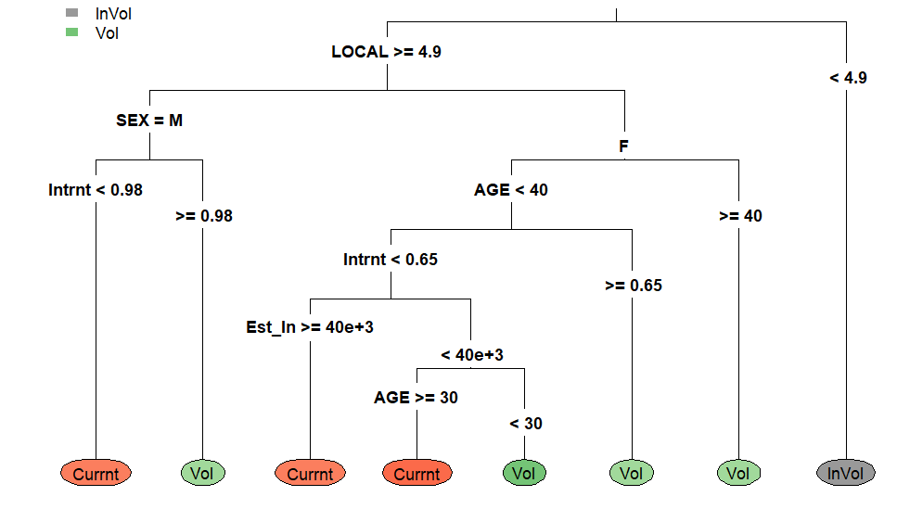
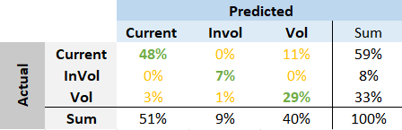
Model
Decision Tree
Decision Tree Model
Each internal node represents a "test" on an attribute - for example local calls more or less than 4.9 min per month
Terminal node represents the outcome (current customer/churn)
Target Variable = Status
Dependant variables all other data other than customer ID number
Model Performance
Correctly classified 90% of voluntary churn
Overall correct prediction = 84%
Confusion Matrix

Slide 7
Key Takeaways
Decision Tree
Involuntary churn tends to occur when customers spend less than 4.9 minutes of local call time, on average
Both males and female customers tend to stay with the Company when they have lower international call times due to the rates
Voluntary churners tend to be females over 40 y.o., females between 30-40 y.o. who make longer international calls, males who make longer international calls, and females under 30 y.o.

Slide 8
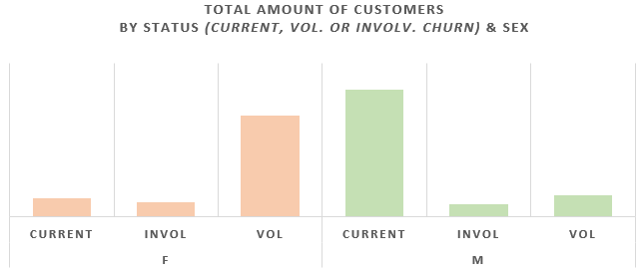
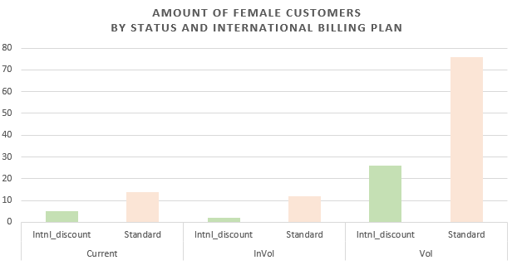
Key Takeaways
The majority of female customers churn voluntarily, while the majority of male customers tend to stay
75% of the female customers that voluntarily leave have the standard plan, instead of the discounted one
The highest churn rates are among customers who spend the most time making international calls and have the highest income
The voluntary churn represents 33% of customers
At an average bill of $60/month*, this results in a loss of $300K yearly, if not addressed
Confusion Matrix
*an assumption

Slide 9
Recommendations
Sponsor may want to consider lowering prices on international calls
Introduce more international plan discounts and promotions based on age
Conduct a targeted-pricing study on international calls to validate the hypothesis presented
Observe what competitors offer in terms of services, packages and discounts/promotions
Contact international calling customers prior to churn and try to convert them from standard-pricing to international-discount
Keeping the customer provides more revenue stability for the Company and reduces switching costs for both parties

